Slide 1

DriverPass
System Analysis
Madison Macachor
Notes:
[No speaker notes required for this slide.]

Slide 2

System Requirements
What the system does
Customers book, change, and cancel driving lessons online. The secretary can do the same by phone or in person.
Customers take online classes and practice tests and see their progress.
You can see who made, changed, or canceled every reservation.
How it works
Runs in a web browser on any computer, tablet, or phone.
Each person gets their own login and sees only what their job needs.
Hosted in the cloud, with backups handled for you.
Notes:
Thank you for meeting with me, Liam and Ian. I'm Madison, the systems analyst on your project. Before I show you the design, I want to remind you of the problem we're solving. More than 65 percent of students fail their driving test because all they did was study old tests. DriverPass fixes that with online classes, practice tests, and lessons on the road. This slide shows what the system needs to do and how it needs to work.
First, what the system does. It does three main things. Customers can book, change, and cancel driving lessons online, and your secretary can do the same for people who call or come in, so every booking lands in one place. Customers can take online classes and practice tests and see how they're doing. And you can see who made, changed, or canceled each reservation, which is the accountability you asked for.
Second, how it works. The system runs in a web browser on a computer, tablet, or phone, so you can check on the business from anywhere. Each person has their own login and sees only what their job needs. And because it's hosted in the cloud, your provider takes care of backups, so you don't need to buy or run any equipment.

Slide 3
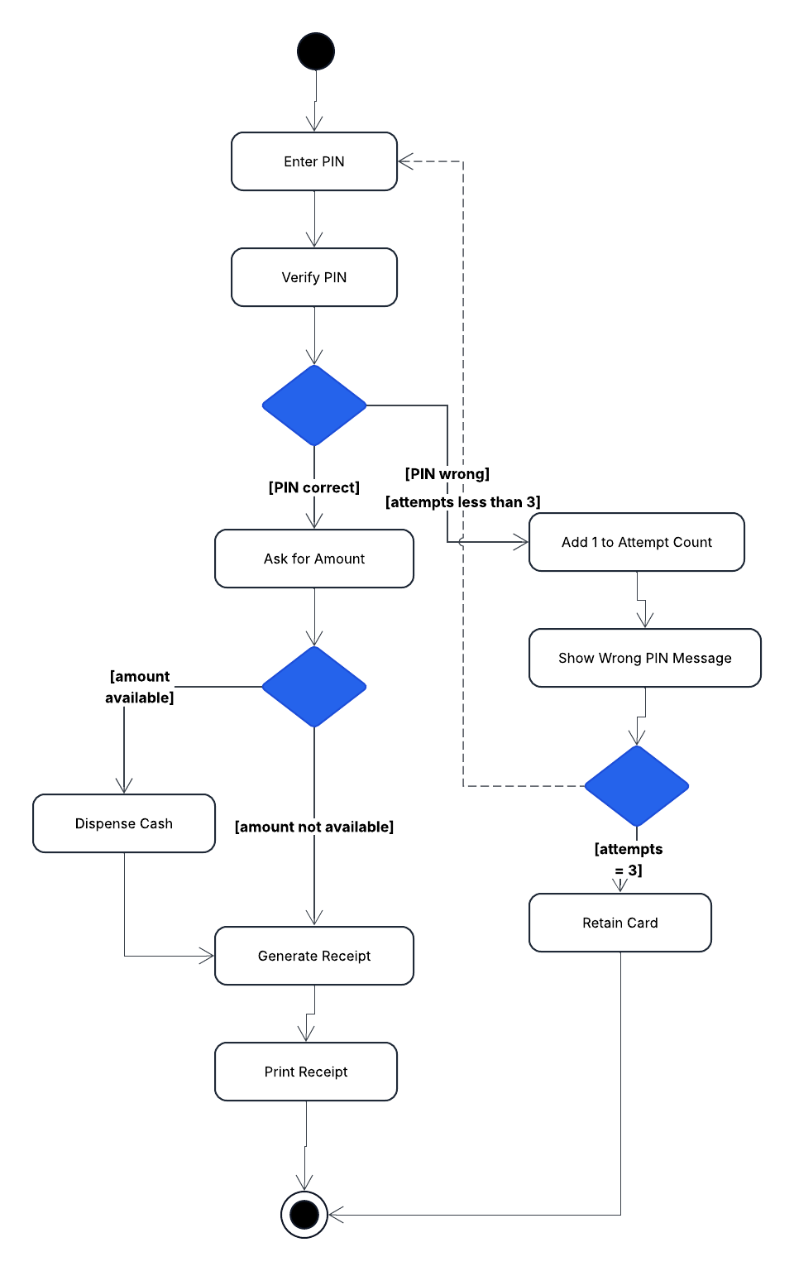
Use Case Diagram
Notes:
This picture is a map of who uses the system and what each person can do. The stick figures are people, and the two on the far side are outside companies that connect to the system. The ovals are the tasks.
Customers can create an account, pick a package, book, change, or cancel a lesson, take online classes and practice tests, check their progress, and contact you. Your secretary can book, change, and cancel lessons for people who call or walk in, which means phone bookings and online bookings all end up in the same place. Liam, you can view reports, driver notes, and test progress, and download reports for Excel. Ian, you can create and manage accounts, reset passwords, block someone's access, and turn a package on or off. Drivers can add notes after a lesson so you can see how each student is doing.
The two outside connections are the DMV and the payment company. The DMV sends us updates when rules or sample questions change, and the system lets you know. The payment company handles credit cards. Every time someone books, changes, or cancels a lesson, the system also records it automatically. That is how you'll know who did what.

Slide 4
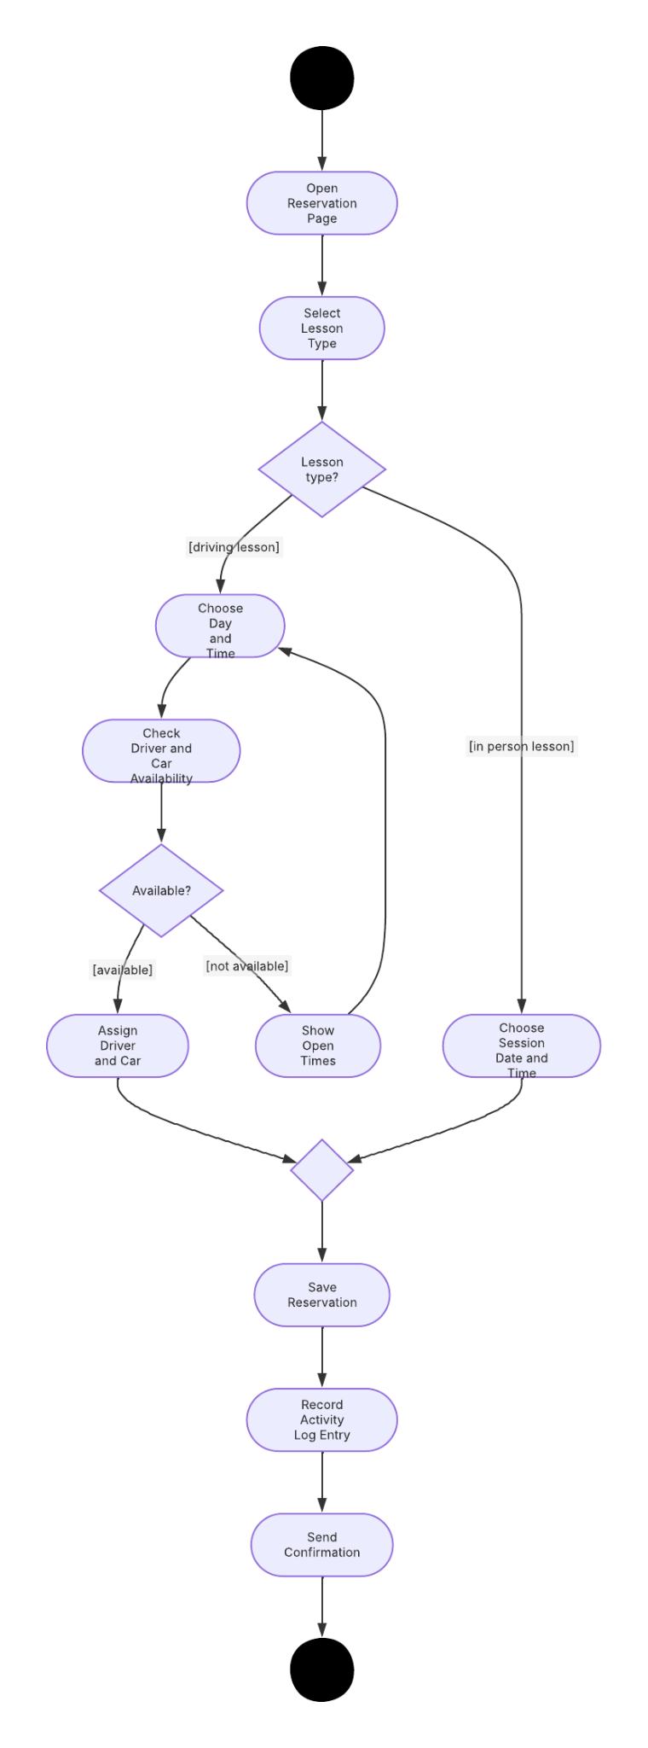
Activity
Diagram
Notes:
This slide breaks down one task step by step: booking a lesson. It's the heart of your business, so I wanted you to see exactly what happens.
The person booking starts by choosing what kind of lesson they want. If it's a driving lesson, they pick a day and time, and the system checks that a driver and a car are free. If they are, the system assigns them. If not, it shows the open times so the person can choose again. That check means no driver or car is ever booked twice at the same time.
If it's the in person lesson on DMV rules, the person picks a session date and time. That lesson doesn't need a driver or a car, so it skips that part.
From there, both paths come back together. The system saves the reservation, records who made it and when, and sends a confirmation. That saved record gives you the accountability you asked for, and the same steps work whether a customer books online or your secretary books by phone.

Slide 5
Security
Every person has a personal login and sees only what their job needs.
Passwords are protected, and an account locks after five wrong tries.
Customers can reset a forgotten password on their own. Ian can block any account right away, such as a former employee's.
Information sent between the browser and DriverPass is scrambled so others can't read it.
Credit cards are handled by a payment company, so DriverPass doesn't keep card numbers.
Every reservation change is recorded with who made it and when.
The cloud provider handles backups and server protection.
Notes:
Security was a big part of what you asked for, so here is how the design protects DriverPass and your customers.
Every person has their own login, and each login only shows what that person's job needs. A customer can't see reports, and the secretary can't change accounts. If someone keeps guessing a password, the account locks after five wrong tries and Ian is notified, so nobody can break in by trial and error. Customers who simply forget their password can reset it themselves without calling anyone. Ian, you have full control over every account and can block one right away, for example when an employee leaves.
Information moving between a customer's browser and DriverPass is scrambled so others can't read it. Credit cards go through a payment company, so DriverPass doesn't have to store card numbers. Every reservation change is recorded with who did it and when, and the cloud provider takes care of backups and protecting the servers.
One note: the five attempts limit is my suggestion, so we should confirm it with you.

Slide 6
System Limitations
Information can only be changed while online. Offline work uses downloaded reports.
Adding new packages or features later needs a developer. For now, packages can be turned on or off.
DMV updates depend on what the DMV is able to send us.
Lessons are limited by your 10 cars and 10 drivers.
The schedule is about 16 weeks, with 10 days for testing, so there's little spare time.
Costs for hosting and the payment company still need to be estimated.
Notes:
Every design has limits, and I want you to know about them now. Nothing here is a surprise to plan around, but it's better to talk about them early.
First, you can only change information while you're online. This avoids duplicate or conflicting records. If you want to work offline, you can download a report and work in Excel at home, but those changes won't flow back into the system.
Second, adding new packages or features later will need a developer. In this first version, you can turn packages on or off, but you can't create new ones on your own.
Third, the DMV updates depend on what the DMV is able to send us. We need to confirm that with them.
Fourth, your 10 cars and 10 drivers set how many lessons can be booked at once.
Fifth, the schedule runs about 16 weeks, and testing gets 10 days, so there isn't much spare time. And finally, we still need to estimate the costs of cloud hosting and the payment company.
I'm happy to take your questions and work through any of these with you.

